Slide 1

Drug Recommendation System Based on Sentiment Analysis of Drug Reviews Using Machine Learning
by
Susmitha G
Roll No. 214G1A32A8
Sabreen Taj B
Roll No. 214G1A3289
Rishitha B
Roll No. 214G1A3286
Siddu Veera Venkatesh B
Roll No. 214G1A32A0
Under the guidance of
Ms. K. Nalini Priyanka,M.Tech.
Assistant Professor
Department of Computer Science and Engineering (Data Science)
Srinivasa Ramanujan Institute of Technology
(Affiliated to JNTUA & Approved by AICTE) (Accredited by NAAC with ‘A’ Grade & Accredited by NBA (EEE, ECE & CSE)
Rotarypuram Village, B K Samudram Mandal, Ananthapuramu – 515701.
2024 - 2025

Slide 2

Contents
Abstract
Introduction
Literature survey
Proposed Work
References
GitHub Link
Queries

Slide 3
Abstract
The COVID-19 pandemic highlighted critical healthcare challenges, including shortages of professionals, equipment, and medicines, leading to self-medication and worsening health outcomes. This study proposes a Drug Recommendation System using machine learning and sentiment analysis to recommend effective medicines for specific diseases based on patient reviews. The system processes datasets, applies machine learning models with vectorization methods like BoW, TF-IDF, and Word2Vec, and evaluates performance using precision, recall, F1-score, and accuracy. By identifying patterns in patient feedback, it ensures recommendations are data-driven and reliable. Analyzed sentiments identify top-rated drugs, enabling informed medication choices and reducing the burden on healthcare providers. This solution is particularly valuable during pandemics, enhancing patient outcomes and supporting constrained healthcare systems, while fostering trust in AI-driven healthcare tools.

Slide 4
Introduction
Sentiment Analysis in Drug Reviews: Sentiment analysis involves determining whether a review is positive, negative, or neutral. It helps analyse the opinions shared by patients about drugs for different medical conditions.
Problem Statement: Patients often struggle to identify the most effective drug for their condition due to overwhelming reviews. Analysing these reviews manually is not feasible, and existing methods lack accuracy. A machine learning-based solution is needed for accurate and faster analysis.
Machine Learning as the Solution: Machine learning models can efficiently analyse large volumes of reviews to predict sentiment. By using multiple classifiers, patterns are identified to determine the effectiveness of drugs.
Objective of the Project: The primary objective of the project is to develop a Drug Recommendation System that:

Slide 5
Introduction
Predicts the sentiment of user reviews.
Generates an overall score for each drug and recommends the most effective drugs based on combined results and review usefulness.
Provides self-medication or self-treatment for people, where access to healthcare has constrained.

Slide 6
Literature Survey
No | Title | Author | Journal Name & Year | Methodology Adapted | Key Findings | Gaps
1. | A Medication Recommendation Framework Based on Sentiment Analysis of Drug Reviews Using AI | Satvik Garg | 2021 11th International Conference on Cloud Computing, Data Science & Engineering (Confluence) | Strategic Regression, Perceptron, Multinomial Naive Bayes, Edge Classifier, Stochastic Gradient Descent, LinearSVC | AI techniques applied to drug review sentiment analysis showed potential for drug recommendation based on sentiments | No mention of specific performance metrics; lack of clear real-world validation for the recommendation system
2. | A Comparative Study of Machine Learning Algorithms and LSTM for Text Classification in Healthcare Data | Siji Rani S, Shilpa P, Aswin G Menon | Journal of Procedia Computer Science, 2024 | Explored supervise ML algorithms & LSTM models for text classification. Preprocessing steps: tokenization, special character removal. Metrics: Accuracy,precision recall, F1-score, confusion matrix. | LSTM effectively handles long-term dependencies in sequential text data like healthcare feedback. ML algorithms provide good accuracy but struggle with imbalanced datasets. | High computational cost for LSTM models. - Challenges in interpretability for deep neural networks. - Hyperparameter tuning difficulties.

Slide 7
Proposed Work
Data Collection
Data Cleaning
& Preprocessing
Feature Extraction
Train Data
Test Data
Model Training
Top Models Selection
Result Merging
Score Calculation
Drug Recommendation

Slide 8
Proposed Work
Feature Extraction: The dataset undergoes transformation to extract meaningful features using four distinct methods:
Bag of Words (BoW), TF-IDF, Word2Vec, Manual Features.
Train-Test Split: The dataset is divided into two parts:
1.Train Data: Used to train machine learning models.
2.Test Data: Used to evaluate the models’ performance.
Model Training: Various machine learning classifiers are applied to the training data for sentiment prediction(e.g.,Logistic Regression, Naive Bayes Classifier).
Models Selection: The best-performing models are selected based on metrics like Accuracy, F1-Score, etc.

Slide 9
Proposed Work
Result Merging: The predictions from the 4 models are merged using an aggregation technique like the class (e.g., positive/negative sentiment) predicted by the majority of the models is chosen as the final result.
Score Calculation: The combined results generate the overall drug score. A higher score indicates a better drug for the specific condition.
Drug Recommendation: Rank all drugs based on their overall scores. Drugs with higher scores are considered more effective and are recommended for the condition.

Slide 10
References
[1]. Satvik Garg, “Drug Recommendation System based on Sentiment Analysis of Drug Reviews using Machine Learning”, 2021 11th International Conference on Cloud Computing, Data Science & Engineering (Confluence).
[1]. P. Sivakumar, [2]. N. Nanthini, [3]. S. Suruthi, [4].T. Veronica, “Drug Prescribing System Using Patient Reviews Based on Sentimental Analysis”, Journal of Coastal Life Medicine, Haikou, China.
[1]. Shubham Throat, [2]. Tushar Bargal, [3]. Rahul Chavan, [4]. Shraddha Ghodekar, [5]. Nilesh Gunaware, “Drug Recommendation System based on Sentiment Analysis of Drug Reviews using Machine Learning”, International Journal for Research in Applied Science & Engineering Technology (IJRASET).

Slide 11
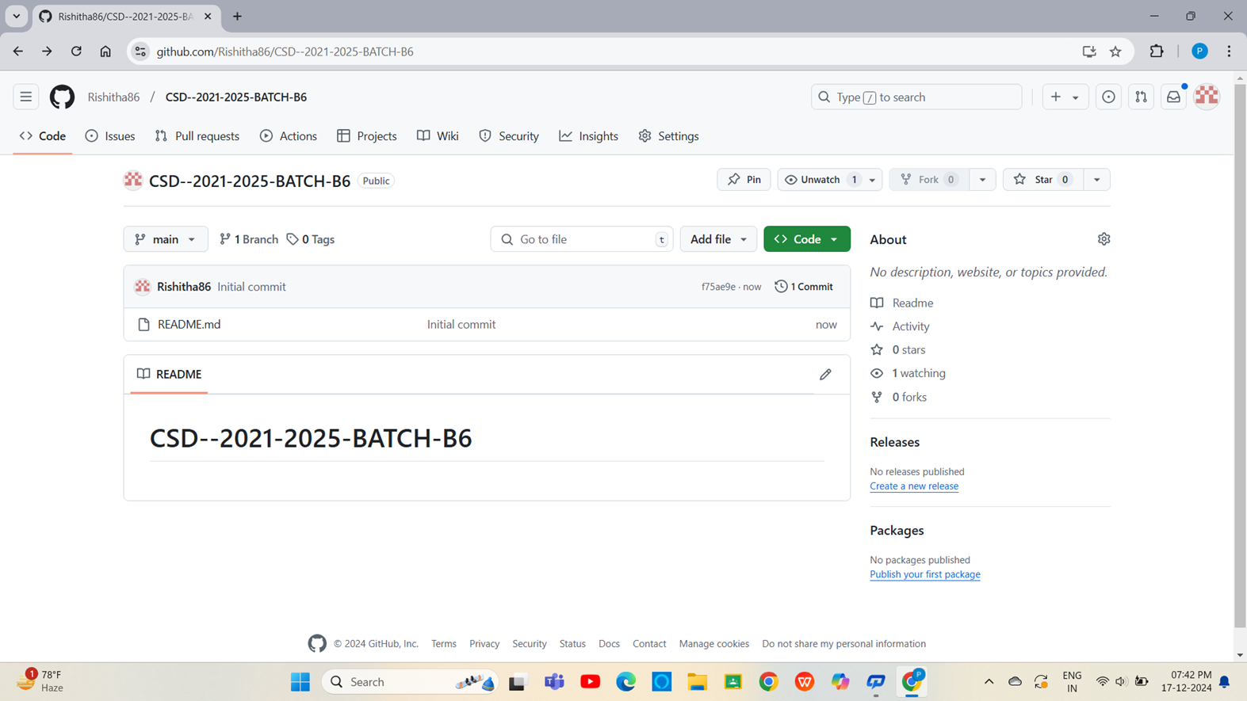

GitHub Link

Slide 12
Any Queries?

Slide 13
Thank You!!!

